Slide 1
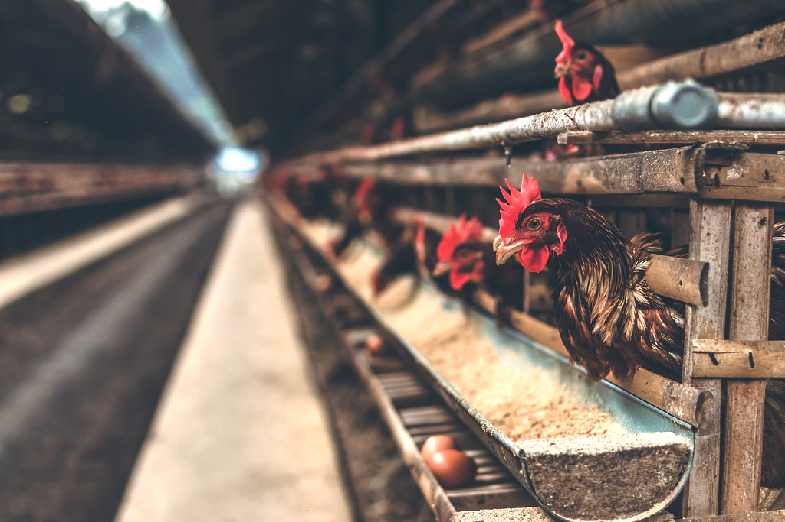
SMART Poultry Farm in Sri lanka Using IoT
22_23-J 35

Slide 2
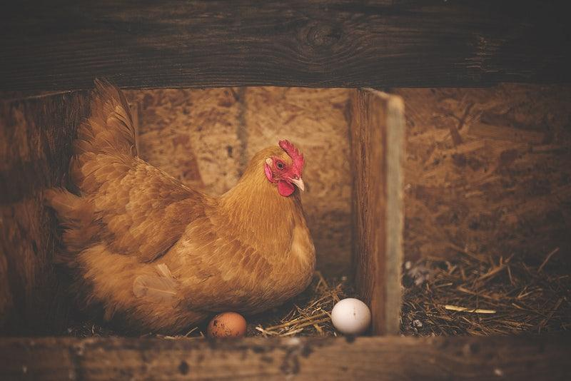
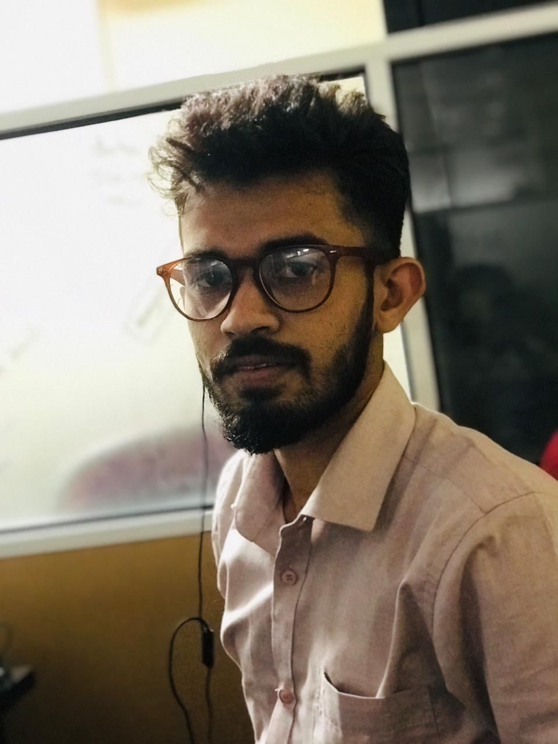



Meet Our Team !
Madushan M.A.C
IT19960128
W.M.W.S Wijesekara
IT19958248
W.A.L.H.P.K Perera
IT19953434
A.M.S.C Ananda
IT19958484

Slide 3
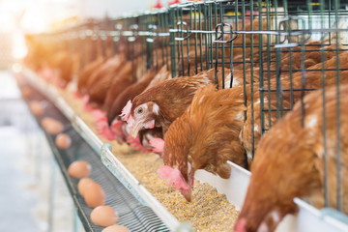
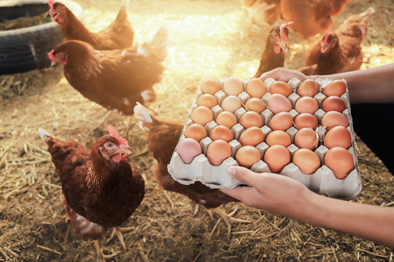
INTRODUCTION
The common poultry farm is spread all over the world and there are very difficult times and threats. Now it has increased the cost and is a threat to the healthy life of the people. Automatic poultry farms have failed in some cases due to the lack of knowledge to operate them.
Even though there are automatic features in the automatic chicken farm as it is now, it is very important to inform the owner of the farm because it is a very important to keep eye on it.
And as we have analyzed how many automatic chicken farms we see, this kind of feature deficiency affects an automatic chicken farm tremendously.
This special features provides a very useful service for a farm.

Slide 4

RESEARCH QUESTION
How to Identify Unauthorized animals for safe egg chamber
how to do overall process within minimum time period
get notify all the details through mobile application
reduce costs by handover human works to machines

Slide 5

IT19960128 | MADUSHAN M.A.C
Specialization : Information Technology
IT19960128 | Madushan M.A.C| 22_23-J 35

Slide 6
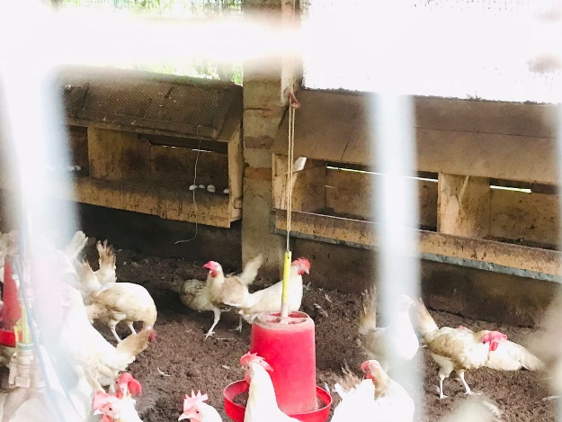
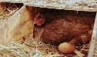
Introduction
Background
Sri Lanka has faced a major problem of decreasing egg production as well as supply, which can be seen due to the increase in cost as the directly affecting factor[1].
It can be seen as a very important task to automatically detect the Unauthorized animals and inform the owner or the cleaner through the app.
Due to rising costs, overall market price increases and demand decreases[2].
Importance of minimizing product damage (Safety)
As a percentage of reduced production due to existing factors[3].
Egg production (2019-2020) - 7%
Issues layer doc - 31%
Imports from countries - 7%
IT19960128 | Madushan M.A.C| 22_23-J 35

Slide 7
Introduction
Research Gap
Research C
Application Reference | Efficiency identification | Solution for low light situation | Highly response time | Technology (using CNN) | Mobile application
Research C[5] | Yes | Yes | No | No | No
Research D[6] | No | No | No | No | No
Research E[7] | Yes | No | Yes | Yes | Yes
Proposed System | Yes | Yes | Yes | Yes | Yes
Existing System poultry farm , but it's not a same like our one , there is a object detention system to identify disease
Research D
it was while elephant detection system for forest , thy used oldest technology for a detection objects
Research E
One of research was india , they are guided object tracking most accurately and using new technology ,
IT19960128 | Madushan M.A.C| 22_23-J 35

Slide 8
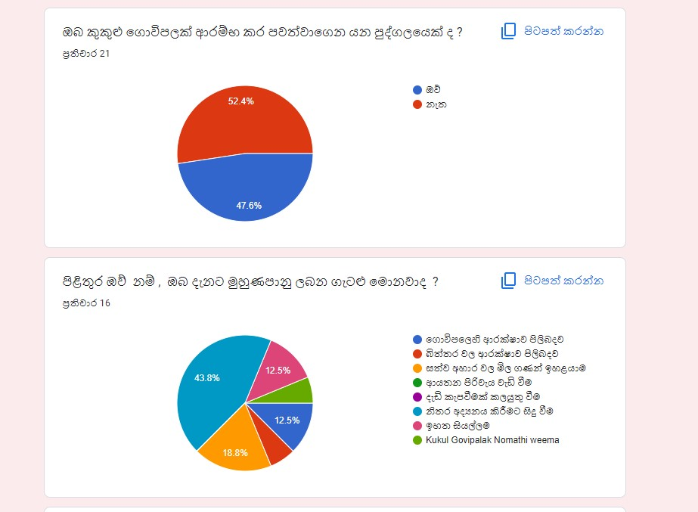
Research Question
Introduction
How to identify unauthorized animals most accurately ??
How to identify unauthorized animal within minimum amount of time?
How to track objects within low light situation ?
How to notify owner through mobile application?
IT19960128 | Madushan M.A.C| 22_23-J 35

Slide 9
Specific and sub Objective
Introduction
Classified captured images
Unauthorized animal Detection system for egg chamber
Collection of image data set to compare for authorized animal detection
If an unauthorized animal is identified, notify the owner quickly
Identify unauthorized objects within minimum time period
IT19960128 | Madushan M.A.C| 22_23-J 35

Slide 10
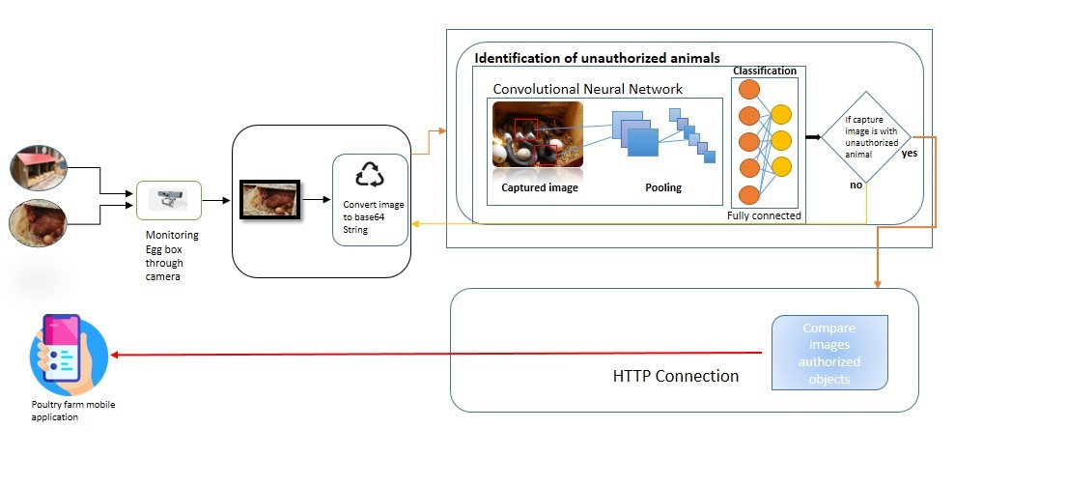
Methodology
System Diagram
IT19960128 | Madushan M.A.C| 22_23-J 35

Slide 11
Methodology
Technologies, Techniques,Algorithems
Python
Tensor Flow
Node server
openCV
Keras
YOLO
Scikit- image
Flutter
CNN
Morphological Image Processing
Gaussian Image Processing(will use best one)
Template Matching.
Image Generation Technique (GAN)
Technologies
Algorithms
Techniques
IT19960128 | Madushan M.A.C| 22_23-J 35

Slide 12
System , Personal and software specification requirements
Methodology
Software Requirements
Personal Requirements
Python
Tensor Flow
Node Server
Jupyter Notebook
Yolo
MongoDB
Devices should be install to the real farm
Functional Requirements
Non-Functional
System should be convert images in to machine understands
System should be able to identify unauthorized objects
System should be able to notify
Mobile application should be unique for this farm
It should be user friendly
Should be high accuracy
Result have to work within minimum time
IT19960128 | Madushan M.A.C| 22_23-J 35

Slide 13
References
[1]Anon., n.d. Neural networks based computer vison systems, 2021: Department of Agricultural and Biological Engineering, Mississippi State University, Starkville,.
[2]college, S. k. a. a. s., 2015. Object tracking using image processing, Coimbatore: Department of BCA and Software System.
[3]health, D. o. a. p. a., Auguest 2021. Poultry Sectir Analysis. 20(Dr. (Miss) D. L. N. Kumudinie (Veterinary Surgeon/Livestock Economics)), p. 20.
[4]James A. Estes, U. o. C. S. C., 2017. Automatically identifying, counting, and describing, uber AI Labs, San Francisco: Department of Computer Science, University of Wyoming.
[5]R Mohan, M. V. A., 2016. Object Detection and Tracking System, India: International Journal of Engineering Research & Technology.
[6]Shevchenkoa, O., 2019. Methods of the Objects Identification and Recognition Research , , Ukraine: State University of Telecommunications.
[7]veerawali, s., 2019. Object detection and Identification , india: university of Georgia.
IT19960128 | Madushan M.A.C| 22_23-J 35

Slide 14
IT19958248 | B.M.W.S.Wijesekara
Specialization : Information Technology
IT19958248 | B.M.W.S.Wijesekara| 22_23-J 35

Slide 15
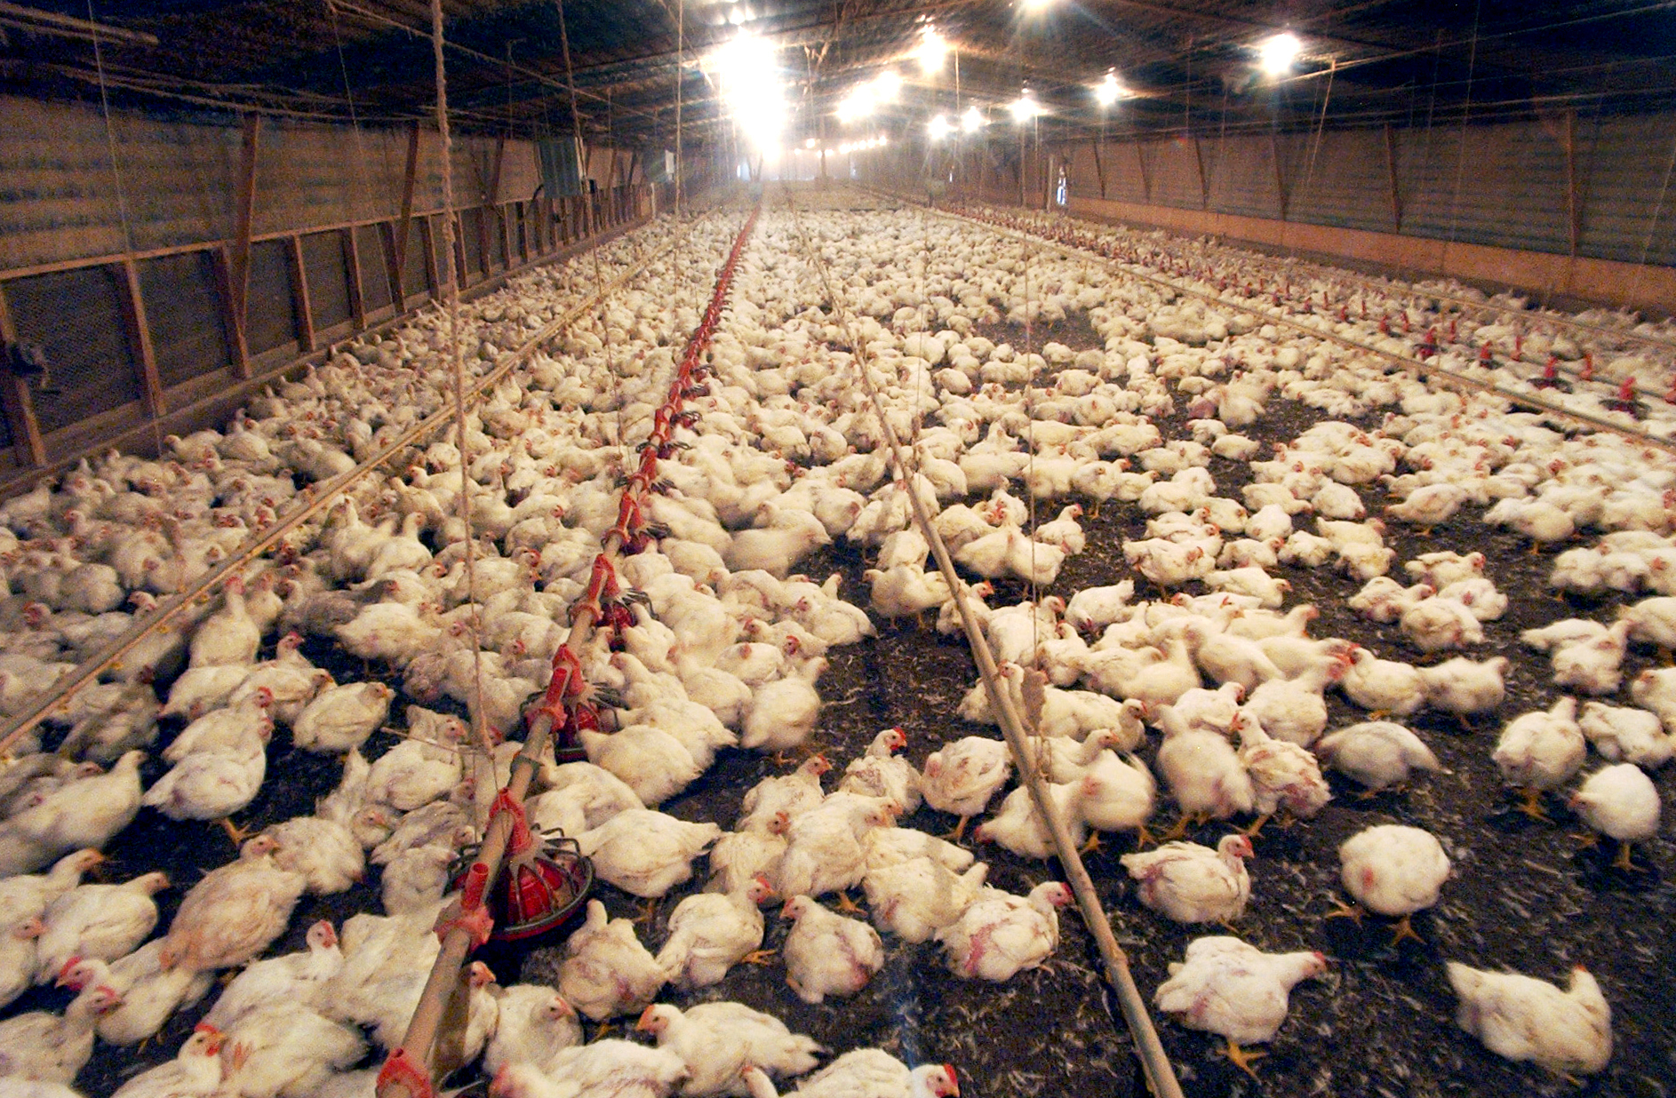
Introduction
Background
Through our project, these poultry houses are expected to be 80% automated. We hope to automate all the things like temperature, humidity, light, food and water in the poultry house through our project.Through machine learning, we hope to provide a prediction of whether the output is productive or non-productive in relation to the production cost, and the measures to be taken for them.This project will enable efficient production at low cost.
IT19958248 | B.M.W.S.Wijesekara| 22_23-J 35

Slide 16
Introduction
Research Gap
Research C
Application Reference | Efficiency Collect Data | Solution for low Production | Highly respons if a decrease in production is detected | Technology | Mobile application
Research C[5] | Yes | Yes | No | No | No
Research D[6] | No | No | No | No | No
Research E[7] | Yes | No | Yes | Yes | Yes
Proposed System | Yes | Yes | Yes | Yes | Yes
Machine learning‐driven dynamic risk prediction for highly pathogenic avian influenza at poultry farms.
Research D
Data challenges and practical aspects of machine learning-based statistical methods for the analyses of poultry data
Research E
Comparison between random forest and gradient boosting machine methods for predicting Listeria spp
IT19958248 | B.M.W.S.Wijesekara| 22_23-J 35

Slide 17
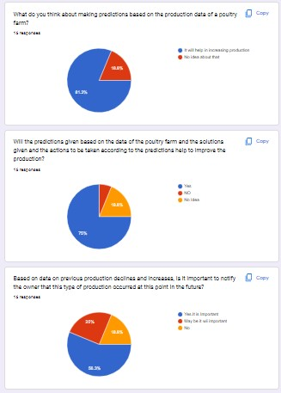
Research Question
What do you think about making predictions based on the production data of a poultry farm ??
Will the predictions given based on the data of the poultry farm and the solutions given and the actions to be taken according to the predictions help to improve the production? ?
Based on data on previous production declines and increases, is it important to notify the owner that this type of production occurred at this point in the future?
IT19958248 | B.M.W.S.Wijesekara| 22_23-J 35

Slide 18
Specific and sub Objective
Obtaining Egg production and cost Data
Prediction of chicken egg Production
Calculating the Production Compared to The Cost and Forecasting the Revenue.
Informs the Owner about the production conditions and indicates the Action and Solutions to be taken
Informing the Owner in advance regarding previous production declines and production falls during the same period in the past.
IT19958248 | B.M.W.S.Wijesekara| 22_23-J 35

Slide 19
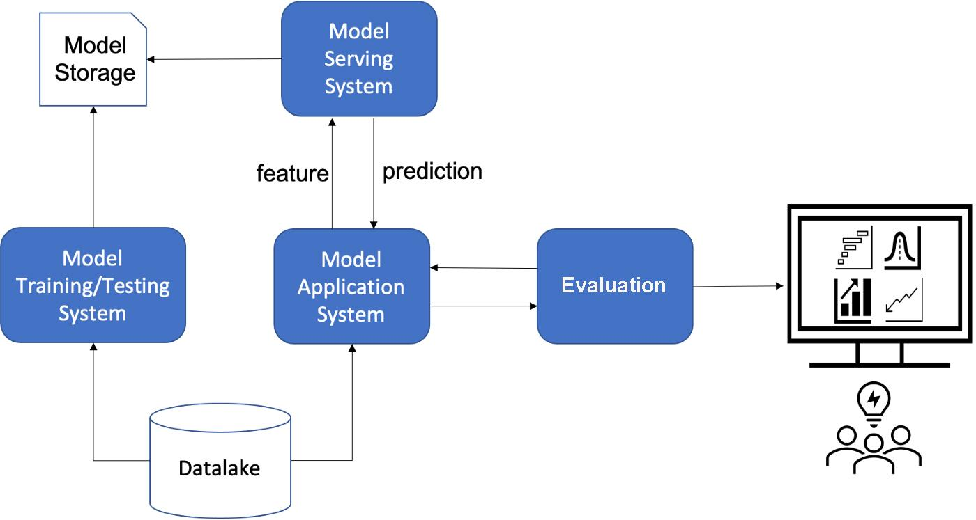
Methodology
System Diagram
IT19958248 | B.M.W.S.Wijesekara| 22_23-J 35

Slide 20
Methodology
Technologies, Techniques,Algorithems
• React JS
• Node JS
• Java
• Robo 3T
• Python
k-means algorithms
decision trees
linear regression
logistic regression
random forests
Technologies
Algorithms
Techniques
IT19958248 | B.M.W.S.Wijesekara| 22_23-J 35

Slide 21
System , Personal and software specification requirements
Methodology
Software Requirements
Personal Requirements
Python
Node Server
Jupyter Notebook
Visual studio code
Firebase
Android studio
Devices should be install to the real farm
Functional Requirements
Non-Functional
System should be Obtaining Egg production and cost Data
System should be able to identifying declines compared to previous month.
Make Predictions Using Production Data.
Mobile application should be unique for this farm
It should be user friendly
Should be high accuracy
Result have to work within minimum time
IT19958248 | B.M.W.S.Wijesekara| 22_23-J 35

Slide 22
7. References
B. MILOSEVIC, B., 2019. Machine learning application in growth and health prediction of broiler chickens, s.l.: Cambridge Core.
Goyal, V., Yadav, A. & Mukherjee, R., 2022. Performance Evaluation of Machine Learning and Deep Learning Models for Temperature Prediction in Poultry Farming, s.l.: IEEE XPLORE.
J.RothrockJrbAbhinavMishra, C. E., 2019. Food Research International. Comparison between random forest and gradient boosting machine methods for predicting Listeria spp. prevalence in the environment of pastured poultry farms, Volume 122, pp. 47-55.
Maurice Pitesky, J. G. ,. T. B., 2020. analyses of poultry data to improve food safety and production efficiency, s.l.: CABI.
Philip J. Hepworth, A. V. N., 2012. Broiler chickens can benefit from machine learning: support vector machine analysis of observational epidemiological data, s.l.: royalsocietypublishing.
Rasheed O.Ojo, A. O. ,. H. A., 2022. Computers and Electronics in Agriculture. Internet of Things and Machine Learning techniques in poultry health and welfare management: A systematic literature review, Volume 200, p. 150.
Yoo, D.-s., 2021. driven dynamic risk prediction. driven dynamic risk prediction for highly pathogenic avian influenza at poultry farms in Republic of Korea, p. 30.
IT19960128 | Madushan M.A.C| 22_23-J 35

Slide 23
IT19953434 | W.A.L.H.P.K. Perera
Specialization : Information Technology
IT19953434 | W.A.L.H.P.K. Perera

Slide 24
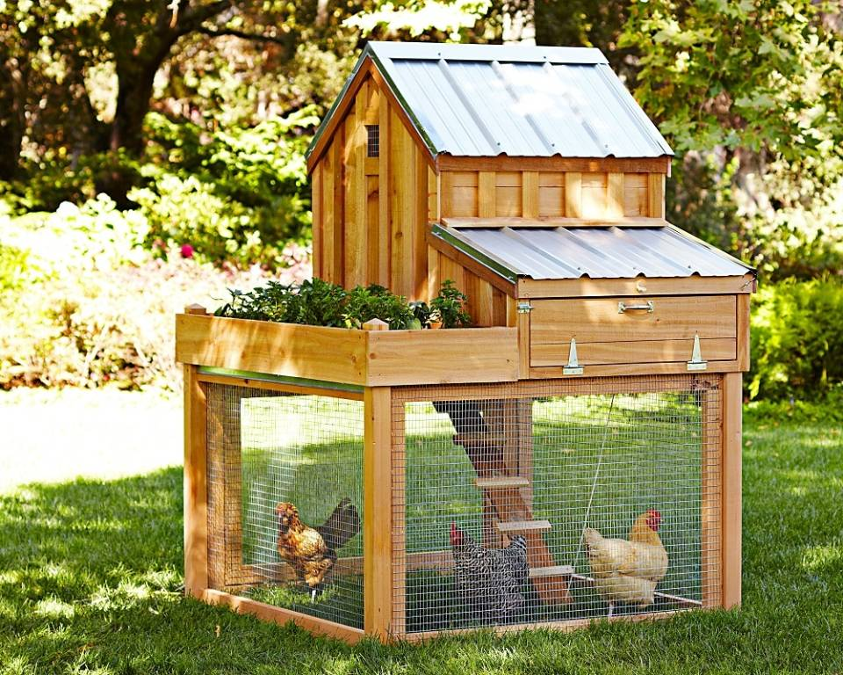
Introduction
Background
In Sri Lanka, the poultry industry is run as a self-employment and also as a large-scale business. But many poultry industries still manage poultry farms using traditional methods..
Due to rising costs, overall market price increases and demand decreases[2].
Importance of minimizing product damage (Safety)
As a percentage of reduced production due to existing factors[3].
Egg production (2019-2020) - 7%
Issues layer doc - 31%
Imports from countries - 7%
IT19953434 | W.A.L.H.P.K. Perera| 22_23-J 35

Slide 25
Introduction
Research Gap
Features | Password-Based Smart Door Locking System | Smart Door Lock and Lighting System using Internet of Things | Smart Door Lock | Smart door lock system with automation and security | Proposed System
Identifying people using face recognition technology | No | No | Yes | No | Yes
Identifying people roaming around the fence. | No | No | Yes | Yes | Yes
Creating the RFID card | No | yes | No | No | Yes
Automatic door lock opening and closing using iot technology | Yes | Yes | No | Yes | Yes
Create an android application and notify the user through it. | Yes | No | Yes | Yes | Yes
IT19953434 | W.A.L.H.P.K. Perera| 22_23-J 35

Slide 26
Research Question
Introduction
Unwanted people and predators enter the farm causing damage to the farm. Therefore, there is a problem of farm and animal safety.
There is a problem with monitoring the overall condition of the farm from the outside.
IT19953434 | W.A.L.H.P.K.Perera| 22_23-J 35

Slide 27
Specific and sub Objective
Introduction
Camera captured images
System for identification of unauthorized persons and animals entering the poultry farm.
Face detections & RFID reader
Face Recognition
Door Unlock
IT19953434 | W.A.L.H.P.K.Perera| 22_23-J 35

Slide 28
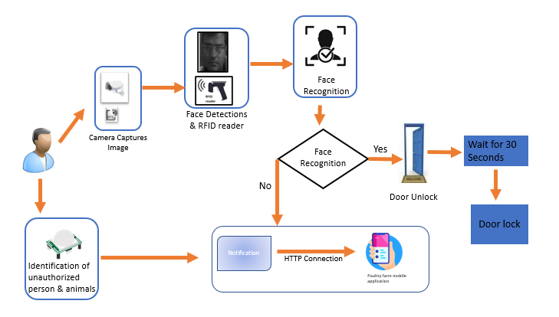
Methodology
System Diagram
IT19953434 | W.A.L.H.P.K.Perera| 22_23-J 35

Slide 29
Methodology
Technologies, Techniques,Algorithems
• React JS
• Node JS
• Java
• Robo 3T
• Python
k-means algorithms
decision trees
linear regression
logistic regression
random forests
Technologies
Algorithms
Techniques
IT19953434 | W.A.L.H.P.K. Perera| 22_23-J 35

Slide 30
System , Personal and software specification requirements
Methodology
Software Requirements
Personal Requirements
Python
Tensor Flow
Node Server
Jupyter Notebook
Yolo
MongoDB
Devices should be install to the real farm
Functional Requirements
Non-Functional
System should be convert images in to machine understands
System should be able to identify unauthorized objects
System should be able to notify
Mobile application should be unique for this farm
It should be user friendly
Should be high accuracy
Result have to work within minimum time
IT19953434 | W.A.L.H.P.K. Perera| 22_23-J 35

Slide 31
References
[1] G. Fortino, A. Guerrieri and W. Russo, Middlewares for Smart Objects and Smart Environments: Overview and Comparison, Springer, Cham, 2014.
[2] C.-L. Hsu and J. C.-C. Lin, "An empirical examination of consumer adoption of Internet of Things services: Network externalities and concern for information privacy perspectives," Computers in Human Behavior, vol. 62, 2016.
[3] Shafin, Kishwar & Kabir, Kazi Lutful & Hasan, Nazmul & Mouri, Israt & Islam, Samina & Ansari,
[4] Zhao, W., Chellappa, R., Phillips, P.J. and Rosenfeld, A. (2003). Face Recognition: A Literature Survey, Center for Automation Research, University of Maryland College,USA.
[5] Schneirdeman, H. A. and Kanade, T. (1998). Probabilistic modelling of local Appearance and spatial reationships for object recognition,Proceedings. 1998 IEEE Computer Society Conference on Computer Vision and Pattern Recognition.
[6] https://lohmann-breeders.com/the-poultry-industry-in-sri-lanka-and-nelfarms/
IT19953434 | W.A.L.H.P.K. Perera| 22_23-J 35

Slide 32
IT19958484 | ANANDA A.M.S.C
Specialization : Information Technology
IT19958484 | Ananda A.M.S.C| 22_23-J 35

Slide 33
Introduction
Background
IT19958484 | ANANDA A.M.S.C| 22_23-J 35

Slide 34
Application Reference | Safety Of Racking | Farmer can control | Low Cost | Egg are not dirty | Mobile application
Development and performance of a mechanical egg collecting system | Yes | Yes | No | Yes | No
Redesign of grain feeder, distributor and egg collector system in poultry farm,” SASTech | No | Yes | No | Yes | No
Visual Guidance and Egg Collection Scheme for a Smart Poultry Robot | Yes | No | Yes | No | Yes
Proposed System | Yes | Yes | Yes | Yes | Yes
Research Gap

Slide 35
Research Question
Introduction
How long does it take to travel to the egg bowl ??
How many egg can be carried to the bowl at one time?
How many times a day is the egg collection done ?
How to notify the owner after this process is over?
IT19958484 | ANANDA A.M.S.C| 22_23-J 35

Slide 36
Specific and sub Objective
Introduction
Eggs are safely moved to the collection bin and securely packing
Egg Collecting And Counting System
Displaying the information about the amount of eggs collected to the farm owner through the mobile App
.
Preventing impurities such as chicken droppings from smearing the eggs
The mobile application facilitates the farm owner to control the egg collection process
IT19958484 | ANANDA A.M.S.C| 22_23-J 35

Slide 37
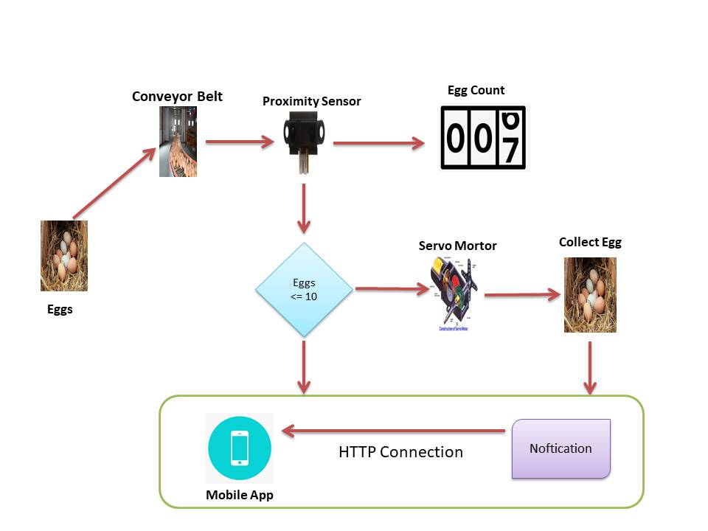
Methodology
System Diagram
IT19958484 | ANANDA A.M.S.C| 22_23-J 35

Slide 38
Methodology
Technologies, Techniques,Algorithems
C
C++
Node server
Rafid
WSN
Flutter
Technologies
Algorithms
Techniques
IT19960128 | Madushan M.A.C| 22_23-J 35

Slide 39
System , Personal and software specification requirements
Methodology
Software Requirements
Personal Requirements
C
Linux
Node Server
IntelliJ Idea
C++
Devices should be install to the real farm
Functional Requirements
Non-Functional
Should be no damage to the eggs
The number of eggs collected should be accarately calculated
The farmer should be able to control the process
Application should be reliable
Should be user-friendly interface
Application should be fast
Should be high efficiency
IT19958484 | ANANDA A.M.S.C| 22_23-J 35

Slide 40
References
1] Circulation, and More. [online] WebMD. Available at: https://www.webmd.com/heart/anatomy-picture-of-blood#1 [Accessed 20 Feb. 2020].
[2] .P. Jacob, H. W. (2019). How Long Do Chickens Lay Eggs? Goals for Laying Hens . actors Affecting Egg Production in Backyard Chicken Flocks, http://edis.ifas.ufl.edu/ps029.
[3] Development and Performance of a Mechanical Egg Collection System Versus the Hand-Operated Dutch Nest. (2015, Oct-Dec ). p. https://www.scielo.br/j/rbca/a/jbrfyjGxLy84T7wvtXBw9rq/?lang=en.
[4].https://www.researchgate.net/publication/347798002_Visual_Guidance_and_Egg_Collection_Scheme_for_a_Smart_Poultry_Robot_for_Free-Range_Farms.
[5] Economist, D. (. (2020). poultry sector analysis and forecast. http://www.daph.gov.lk/web/images/content_image/news_bulletins/poultry_industry_monthly_report/2020/PoultrySectorForecast_2020_colour.pdf.
[6] Gamage, A. (2019). Equipping Tomorrow's Poultry Leaders in the South and Southeast Asia Regions. https://ussec.org/equipping-tomorrows-poultry-leaders-in-the-south-and-southeast-asia-regions/.
[7] Hamza, M. (2022 , March 24). Sri Lanka chicken and eggs in crisis as soft-peg hits feed. pp. https://economynext.com/sri-lanka-chicken-and-eggs-in-crisis-as-soft-peg-hits-feed-91996/.
[8] TEXHA. (2020). EggStream egg collection system. pp. https://texha.com/equipment/egg-production-equipment/eggstream-egg-collection-system/.
IT19958484 | ANANDA A.M.S.C| 22_23-J 35

